Slide 1
NW Power and Conservation Council’s 2021 Power Plan Salem City Club Program March 18, 2022 Powering the Northwest: Can Green Power Keep the Lights On?
John Fazio Senior Systems Analyst

Slide 2
Topics
What is the NW Power and Conservation Council?
What jurisdiction does the Council have?
The Council’s forecast for future resource needs
The 2021 Power Plan resource strategy
Planning for a decarbonized future

Slide 3
The Northwest Power and Conservation Council
The 1980 Northwest Power Act authorized Idaho, Montana, Oregon, and Washington to develop a regional Power Plan and Fish and Wildlife Program to balance the Northwest's environment and energy needs.
Each state legislature passed laws to form the NWPCC
The governors of each state appoints two Council Members
Predominantly funded by rates collected by the Bonneville Power Administration

Slide 4
The Council’s Power Plan
The Council’s objective is to develop a long-term resource and energy efficiency acquisition strategy that ensures an adequate, efficient and economic power supply
Major components of the plan include:
Forecast of regional electricity demand over the next 20 years
A “least cost with acceptable risk” resource strategy
Regional action plan

Slide 5
What jurisdiction does the Council have?
By statute, the plan guides Bonneville Power’s generating resource and energy efficiency acquisition decisions
By tradition, the plan serves as an independent reference for all regional utilities, regulatory commissions and other policy makers
The Council recognizes that utilities have differing needs and that its regional power plan is not intended to be a substitute for individual utility resource plans. Each utility must assess its own needs and future resource requirements. The plan offers a set of cost-effective resources that utilities should consider as they develop their own resource acquisition plans.

Slide 6
Council’s Interactions with other Entities
Regularly scheduled public Council meetings throughout the region
Public Advisory Committees System analysis, Resource adequacy, Load forecasting, Generating resources, Energy efficiency, Demand response, Natural gas, System integration
Participation in regional, national and international forums on power planning Other regional stakeholders, Universities, Utilities, Utility commissions, Western Electricity Coordinating Council (WECC), Western Interstate Energy Board (WIEB), North American Electric Reliability Corporation(NERC), Institute of Electrical and Electronics Engineers IEEE), National Labs (PNNL, LBL, NREL)

Slide 7
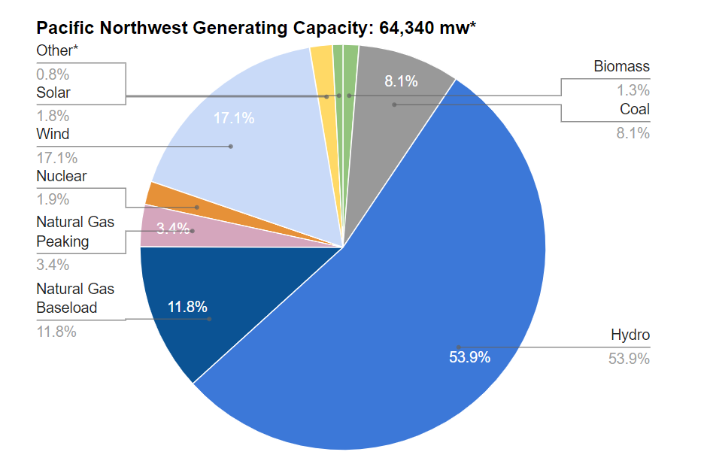
Pacific Northwest Power Supply
The region has also reduced electricity demand by 7,200 average megawatts since 1980 though the Council’s energy efficiency measures and through standards and codes.

Slide 8
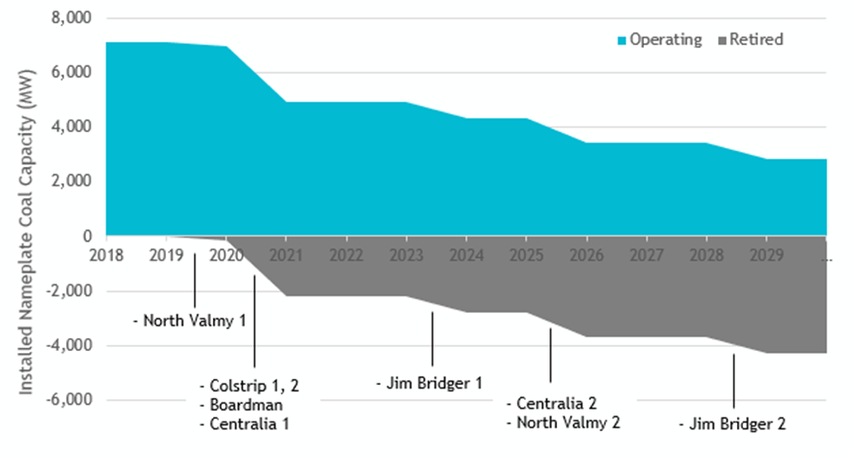
Announced Coal Plant Retirements
Over 4,000 MW by 2030

Slide 9
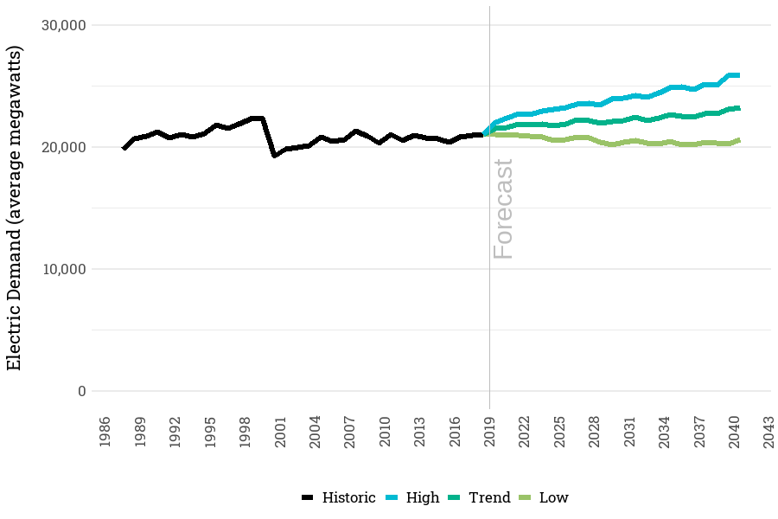
Forecast of Regional Electricity Demand
Based on a wide range of future economic conditions that include effects of climate change on temperature and precipitation:
-5% to +4% by 2027
-8% to +7% by 2041
Does not include:
Climate change effects on population and demographics
Increased demand stemming from future electrification policies and actions

Slide 10
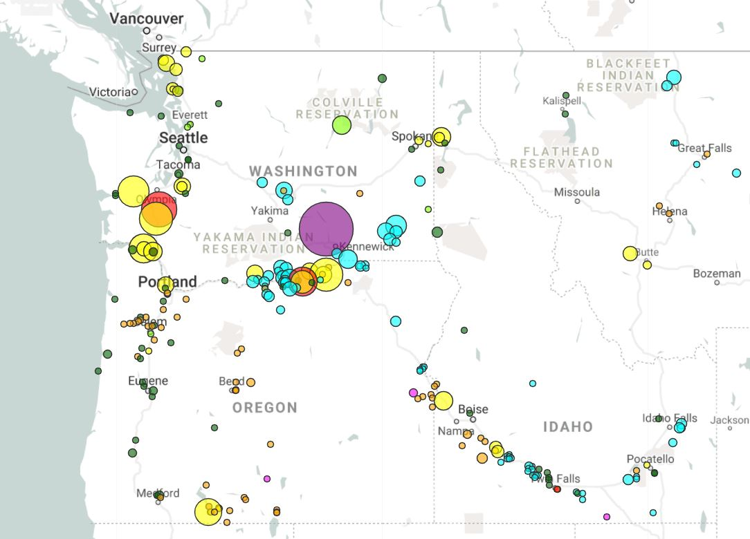
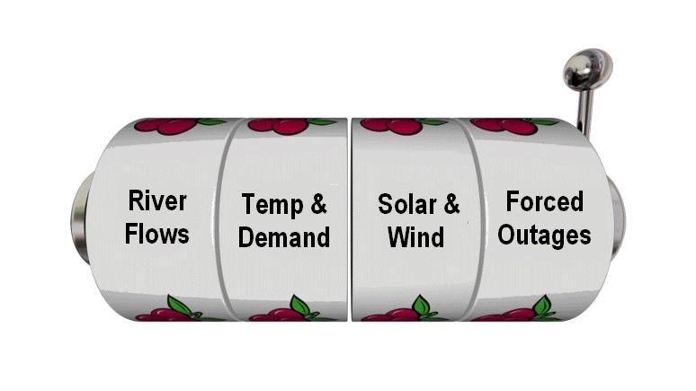
Assessing Resource Adequacy for the PNW
GENESYS: Chronological hourly simulation of all PNW resources for one year
Thousands of simulations with different combinations of future unknowns
The Council deems the power supply to be adequate if the likelihood of having one or more shortfalls in a future year is less than or equal to 5 percent (i.e., LOLP ≤ 5%)
Record all hours when load cannot be served
Annual Loss of Load Probability:
LOLP = Number of simulations with shortfalls
Total number of simulations

Slide 11
Future Policies Are Also Uncertain
Many scenarios with differing future policies were examined:
Baseline conditions (current policies)
Early coal plant retirement
Changes in the availability and organization of electricity markets
Aggressive decarbonization policies
Future capacity needs over the 20-year study horizon vary widely
Council focuses on resource needs through 2027, when the next plan is due
Council uses judgement based on results from all scenarios to develop a resource strategy that provides an adequate supply without overbuilding

Slide 12
2021 Power Plan Resource Strategy
Energy Efficiency
750 to 1,000 aMW by 2027
Minimum of 2,400 aMW by 2041
Renewable Resources
3,500 MW by 2027
Includes a mix of wind, solar, biomass, distributed generation, etc.
Demand Response
520 MW of Demand Voltage Regulation
200 MW of Time-of-Use rates
Explore potential of new market tools, such as capacity and reserves products, that contribute to system accessibility and efficiency

Slide 13
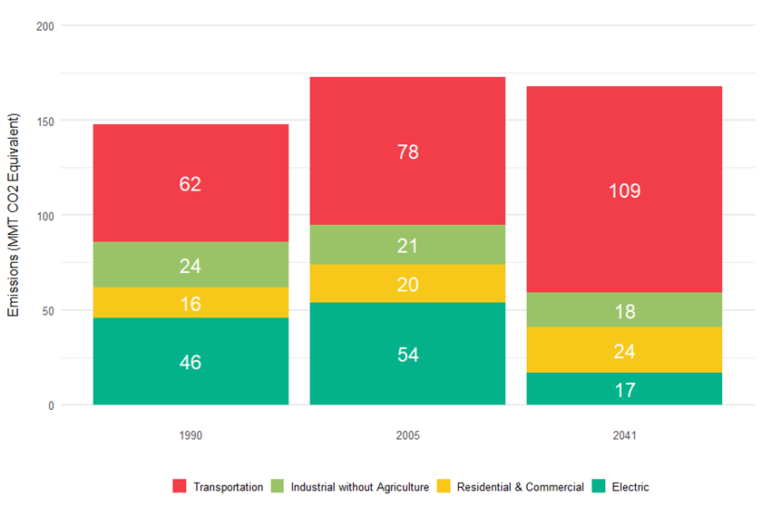
Historic and Projected PNW Emissions by Sector (Baseline case, no new electrification policies)
Even though emissions from the energy sector drop, those from transportation are expected to rise under baseline conditions.

Slide 14
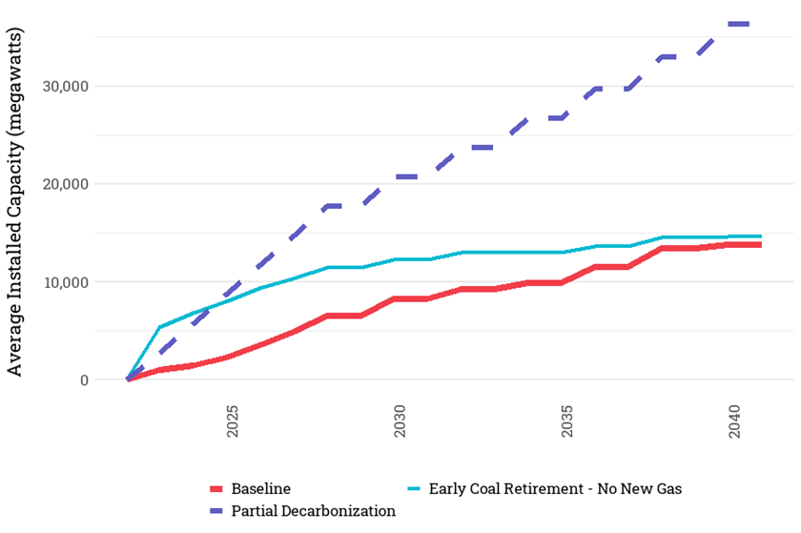
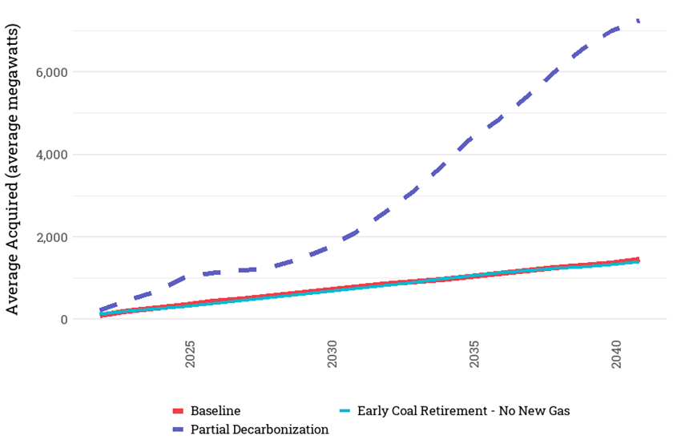
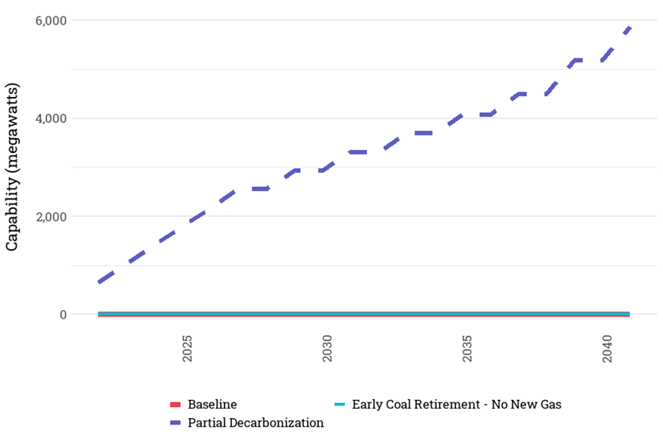
A green future will rely heavily on EE, DR and Renewables but can only achieve a partial decarbonization (see next slide)
Renewables
Energy Efficiency
Demand Response
Over 35,000 MW by 2041
Over 7,000 aMW by 2041
About 6,000 MW by 2041

Slide 15
Summary of Findings for the Decarb Scenario
Electrification strategies could push demand to over 300 percent of current levels (from 20,000 to about 67,000 aMW by 2050).
Given current technologies, the power sector, even under aggressive decarbonization policies, can’t reach zero emissions by 2050.
Increases in EE, DR and renewables from the previous slide are from a partial decarbonization scenario.
Replacement of vehicles, appliances and equipment in homes, businesses, and manufacturing was at an accelerated but possibly obtainable pace.
Electricity demand increased by about 50 percent.
Mitigation strategies in the non-energy sector are critical for major reductions in CO2e emissions.

